Slide 1
Azure Functions in Office 365
Building Serverless Solutions

Slide 2
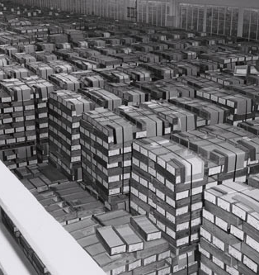
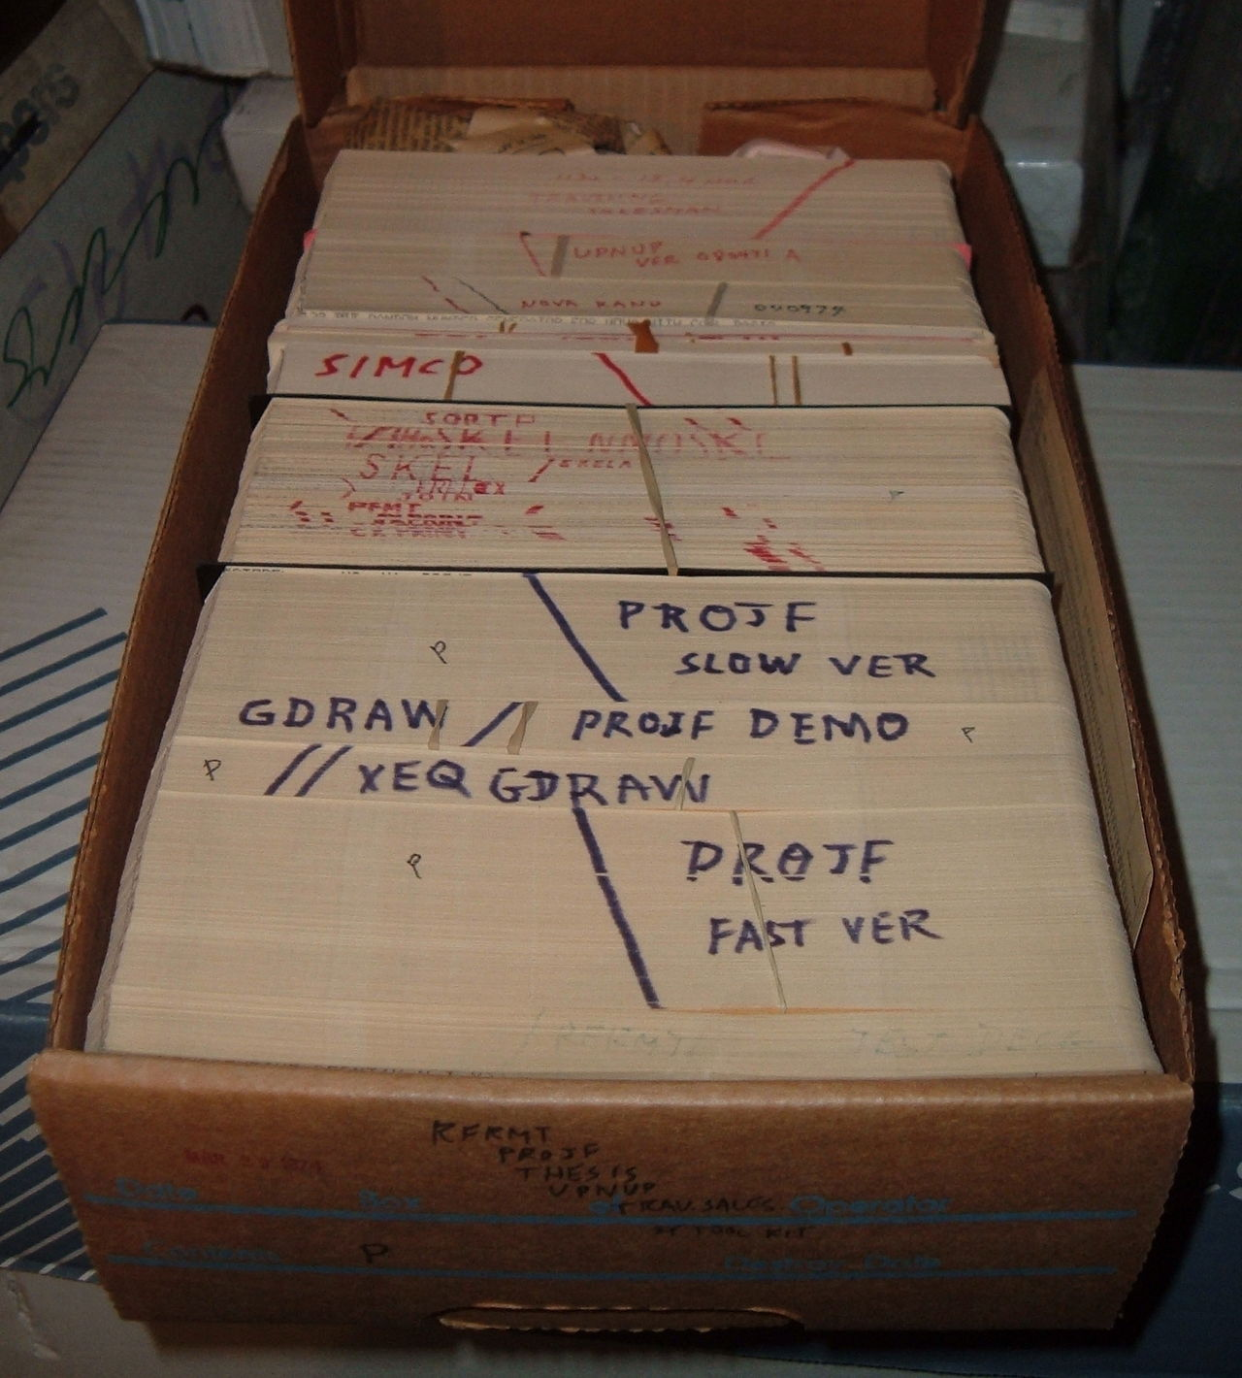
About John
Senior Consultant SharePoint Gurus Sydney
SharePoint Server MVP Office Server and Services
User Groups, SharePoint Conferences
http://johnliu.net
@johnnliu fun fact: I grew up in the streets of Auckland then I became a kiwi-export
Notes:
Pictures from
https://en.wikipedia.org/wiki/Computer_programming_in_the_punched_card_era
Mother worked early to late 1970s.
The machines at the Statistic Bureau of Taiwan were retired in the first few years.
https://commons.wikimedia.org/wiki/File:IBM_card_storage.NARA.jpg
1959 – 4GB

Slide 3
Agenda
Quick look
What is Azure Functions / Serverless
Demos, demos, demos!

Slide 4
Demo: Quick Look Azure Functions

Slide 5
What is “Serverless”
It is a buzzword
Describe an emerging architecture of writing microservices on top of “Functions as a Service”
What it is not… It doesn’t mean no servers

Slide 6
The essence of Serverless
Reduce the code that you write
Pay only what you use
Autoscale on demand
Event driven – respond to events and triggers
Notes:
Reduce code that you write – use libraries that are well tested, use framework to provide scaffolding and access to other resources like storage, queue
What you don’t write, you don’t have to maintain.
Pay only what you use - when the code don’t run, you don’t pay
Servers exist. But they are not your concern. - servers are not your responsibility
Why is this suddenly popular now? Because Amazon (and Microsoft) started selling Functions as a Service at a cheap rate. The price point made this type of setup worthwhile.

Slide 7
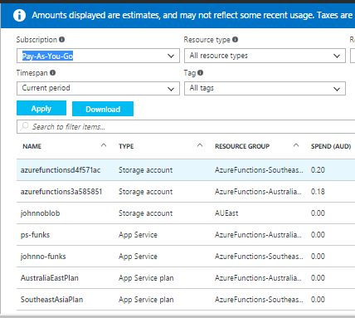
In Practice - Costs

Slide 8
Demo - C# (CSX)
Notes:
https://blogs.msdn.microsoft.com/webdev/2016/12/01/visual-studio-tools-for-azure-functions/

Slide 9
Demo - NodeJS
Notes:
johnno-funks
demo-pnp-sp-core-nodejs

Slide 10
Demo - PowerShell & PnP
Notes:
Funky-demo
* demo2-sites-create
* demo3-graph-group-pnp
* get-list-and-email

Slide 11
Demo – Swagger
Notes:
Swagger
Flow
PowerApps
C:\r\provisioning\spg-swagger.json

Slide 12
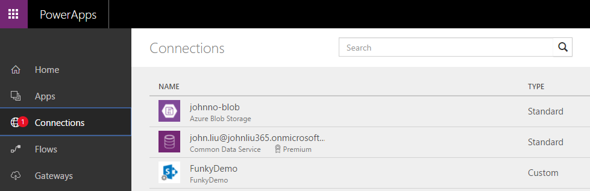
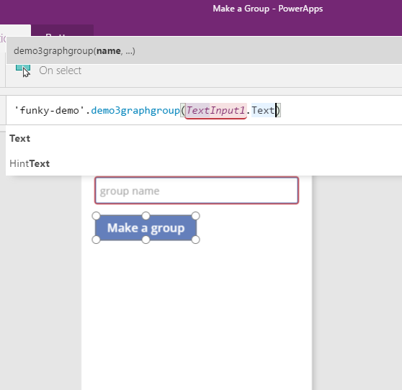
PowerApps with Functions

Slide 13
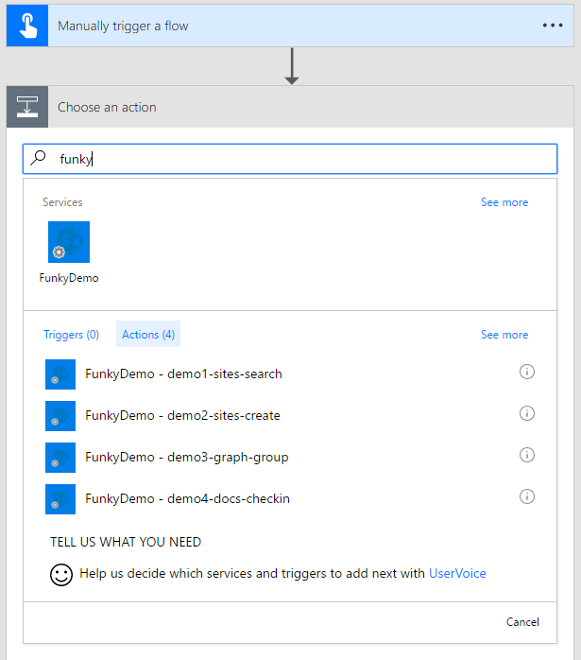
Flow with Functions

Slide 14
What would you build tomorrow?
I know this sounds like a crazy cat poster – but its true
What could you build if you have infinite parallel compute at (almost) zero cost?

Slide 15
Connect
Webhook - SharePoint / MS Graph
Flow / Logic App
PowerApps
SharePoint 2013 Workflows
BotFramework
Chat Connectors – Teams, O365 Groups, Slack, Facebook

Slide 16
Developers
Most choices
C# for speed, VSNET tooling
F# because it rocks
CLR languages can be compiled
TS / JS for frontend dev, NodeJS and VSCode
JS languages can be webpacked
PowerShell if you are just lazy like me, and it’s very readable and leverages great work done by PnP Team

Slide 17
IT Pros
PowerShell skills can be reused to build incredible microservices that can solve complex business needs.
You can probably teach a dev a thing or ten about PowerShell

Slide 18
Power Users
Work with developers or IT Pros to build a set of microservices
Add Swagger API to extend Logic App, Flow and PowerApps

Slide 19
Question
How many of you have had a requirement that needed a machine in the cloud (may be an Azure VM or WebJob)
And after talking with stakeholder – you went and redesigned the solution to go without
Notes:
Hands stay up if they are eating your credits right now

Slide 20
Serverless “spectrum”
Cloud-Curious
Micro/web-services for everyone
Use your favourite language
Elevate permission
Webhook / Event Receivers
Timer Jobs
Extend Flow (custom workflow action)
Cloud-Serious
Idempotent
Combine Message Queues / Service Bus & scale Functions
Throw Exceptions to trigger retry
Azure Function Proxies
Serverless web apps = CDN + Functions
📷
Notes:
If you are reading this.
You have found the best slide in the deck

Slide 21
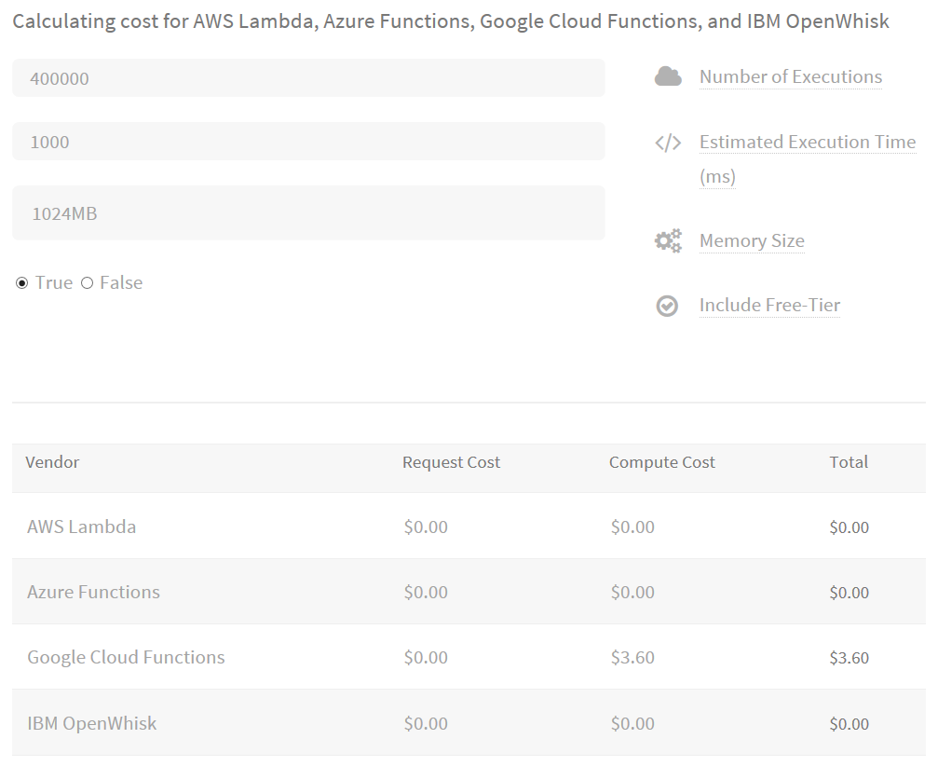
Cost
http://serverlesscalc.com/

Slide 22
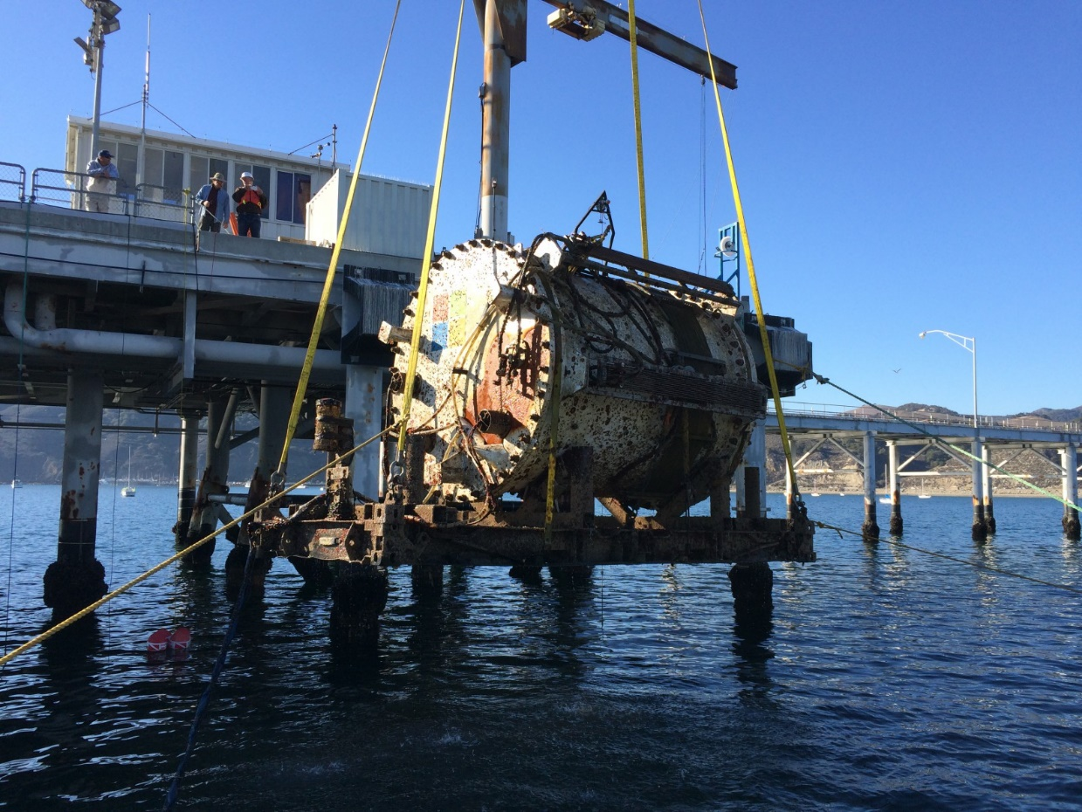
Celebrate 55 years of computing
Federal records center (Virginia US) 1955~66 4GB
Project Natick 2016
Notes:
1959 – 4GB
2016 – data center

Slide 23
Summary
Azure Functions & Serverless Architecture
Lots of demos
What you can build
Dream about a Serverless future

Slide 24
FAQ
Flow vs Logic App vs Azure Functions
Logic App is Azure orchestration engine (also good for workflows)
Flow is a no-code (IFTT) skin for Logic App
Azure Functions is just one function. Flow/Logic Apps can use
Azure Functions vs Amazon Lambda (leader)
Functions has two datacenters in Australia (SYD/MEL)
Functions build on top of App Service and has dedicated plans
Amazon Lambda supports C# as well. Functions does F# and PowerShell
Functions has much better tooling in VSNET
Azure Automation
Azure Automation has runbooks of PowerShell scripts, dedicated VM
Input/Output/Trigger different

Slide 25
Other sessions
Tuesday 12:15 pm Deep Dive – The NEW SharePoint (Development) Framework
Tuesday 4:45 pm Building Your Own Solution with Power Apps and Flow
Azure Functions team best practice guide https://docs.microsoft.com/en-us/azure/azure-functions/functions-best-practices
PnP – calling secured Functions from SPFx https://dev.office.com/blogs/calling-external-apis-securely-from-sharepoint-framework

Slide 26
Questions and Feedback
What do you guys think?

Slide 27
Thank you https://functions.azure.com/try Chat with me in the Speaker Lounge @johnnliu http://johnliu.net https://github.com/johnnliu/azure-functions-o365
📷

